Slide 1
Advanced Java Programming
Object Relational Mapping

Slide 2
Contents
What is Object Relational Mapping
How ORM Works
Features of ORM
Advantages
Java ORM- Hibernate, JAVA Persistence API(JPA)
ORM Implementation

Slide 3
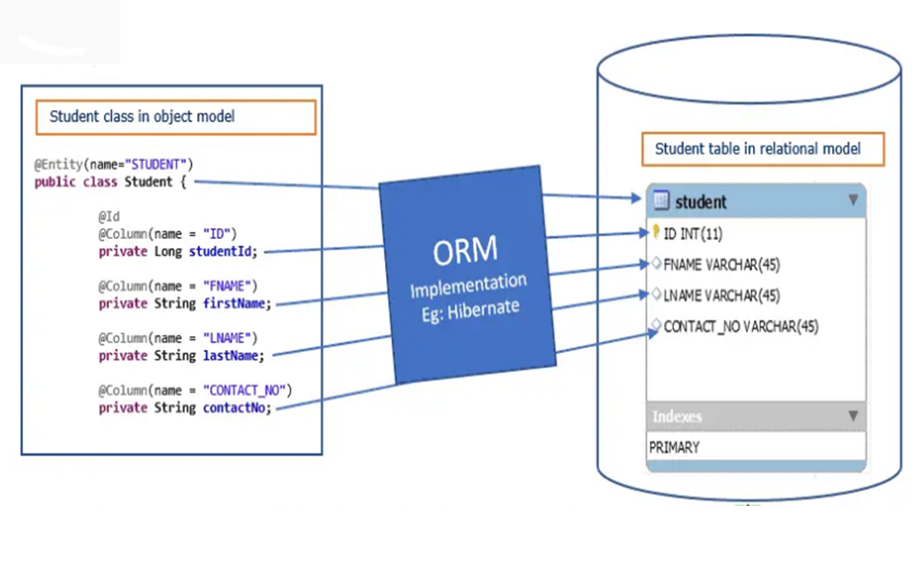
ORM

Slide 4
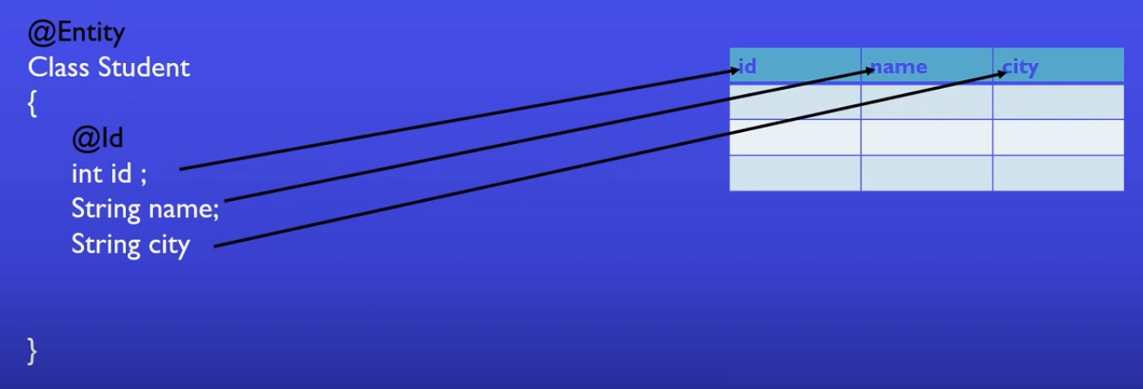
ORM
Annotations Mapping

Slide 5
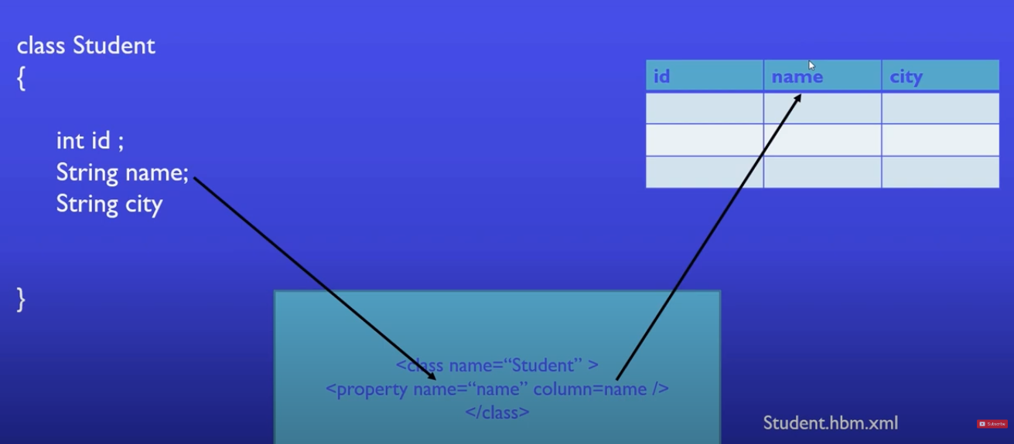
ORM
XML Mapping

Slide 6
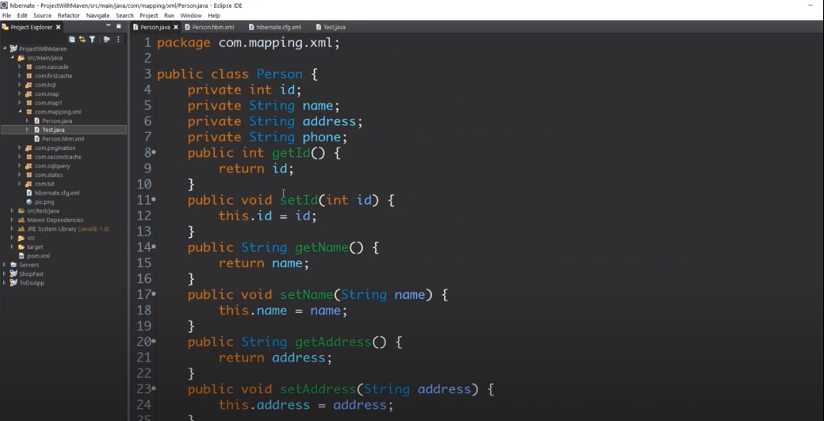
ORM
Person.java

Slide 7
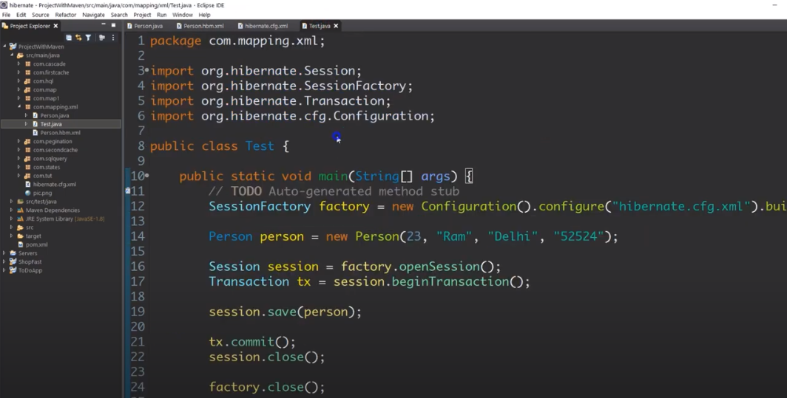
ORM
Test.java

Slide 8
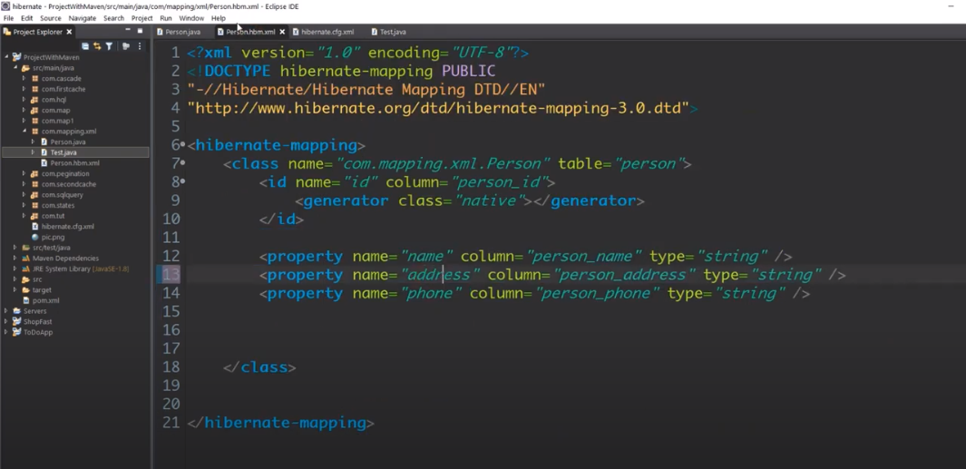
ORM
Person.hbm.xml

Slide 9
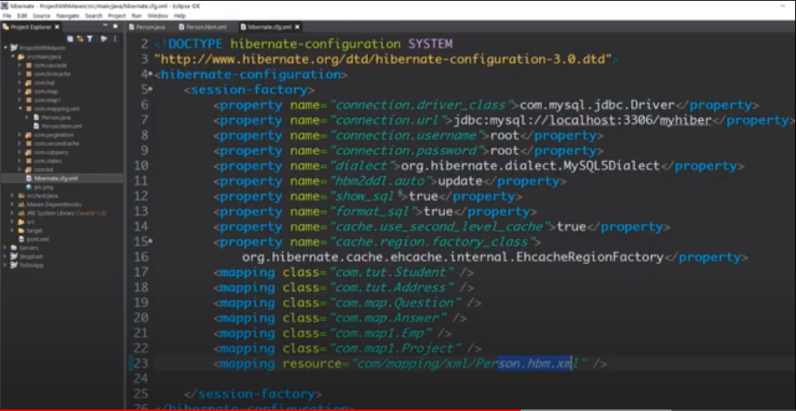
hibernate.cfg.xml

Slide 10
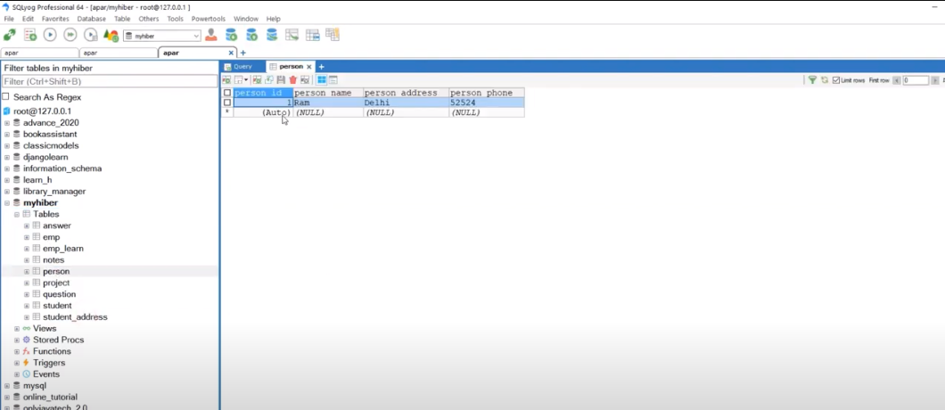
ORM
Result in Table

